Slide 1
Capstone Presentation
PGPDSBA
Life Insurance Sales
Karthick Raj S

Slide 2
Business Problem Understanding
The Company is selling Life Insurance Financial Products to its customers through agents mostly.
The amount paid by the customers is the main source of income for the company.
The Company will have many ventures & investments also while they have the customer’s money till the policy reaches maturity.
The Bonus given to the agents are part of the employee's compensation which is an cost incurred by the company.

Slide 3
Need for the Study
The Objective of the problem statement is to predict the monthly bonus of the insurance company agents.
This will help to
Design engagement & upskilling programs for their agents.
Plan for the employee compensation cost.
Dataset Description
The Dataset contains the Life Insurance Policy Details, Bonus Amount given to the agents and the Customer Details.
The Dataset is collected at the end of each month. It is a monthly data.

Slide 4
Modelling Approach Used & Why
Basic data cleaning and Removal of outlier are performed.
Cluster Analysis is performed as part of EDA.
The Data is scaled and split into Train and Test with 70:30 Ratio.
The Model built are Linear Regression, Ridge Regression, Lasso Regression, SGD Regression, CART, K-Neighbor Regressor, Random Forest Regressor and Ensemble Models.
The Ensemble models used are CART Bagging, XG Boost, ADA Boost, Voting and Stacking Regressor.

Slide 5
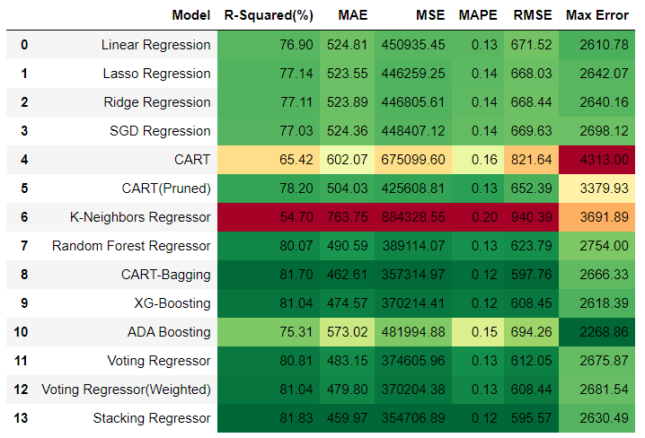
Model Metrics
14 Models
K-Neighbors regressor performed poorly.
Stacking Regressor has 81.83% R-Squared value and least error.

Slide 6
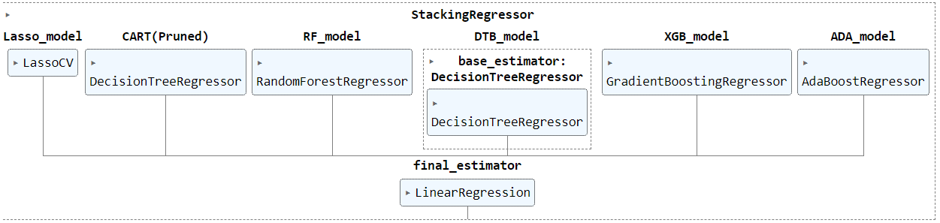
Stacking Regressor
81.83% of all movements of dependent variable are completely explained by movements in the other independent variables. (Stacked Regressor)
The RMSE for Stacking Regressor model is 595.57.
Most Optimum Model for the prediction.

Slide 7
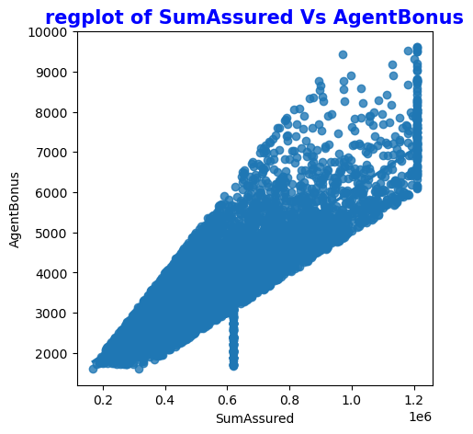
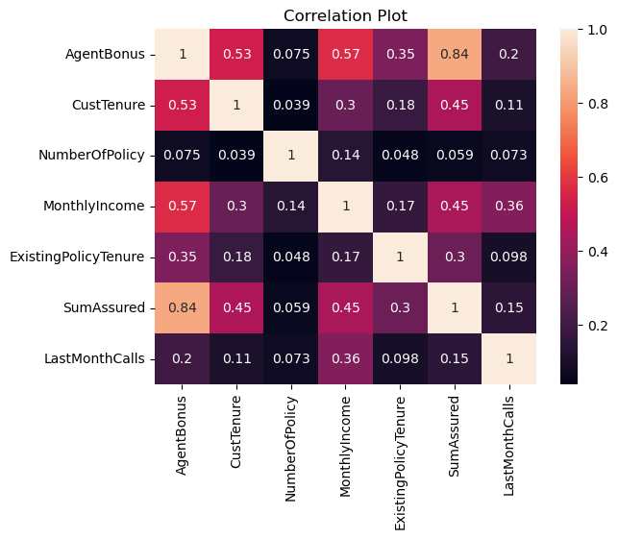
Insights from Analysis
As the SumAssured increases, Agent Bonus also increases.
AgentBonus and SumAssured has High Positive Correlation.

Slide 8
Insights from Analysis(Contd.)
Age has some Invalid data. 42.43% of Customer’s age are less than the customer work experience. The Age column has been dropped.
From the models, the most important features are
SumAssured
MonthlyIncome
CustTenure

Slide 9
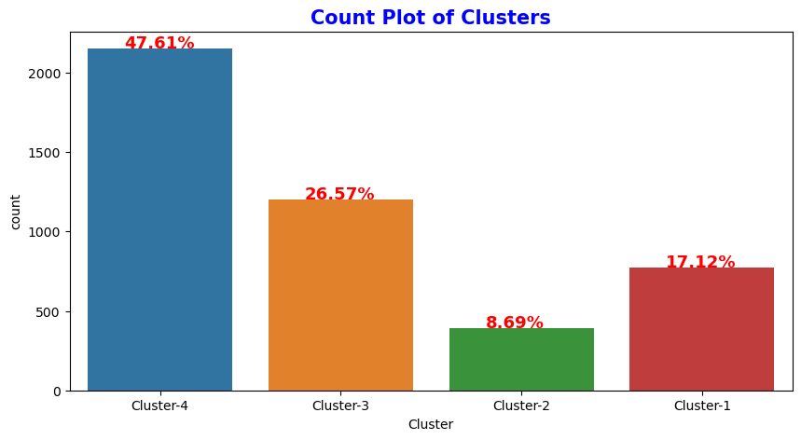
Insights From Cluster Analysis
4 Cluster are formed from the Cluster Analysis.
Cluster 4 has the highest customers and their average sum assured is moderate. They are the most common customers to buy insurance.
The Premium Customers are in the Cluster 3. They are mostly working as VP.
Cluster 1 and 4 can also more focused on top up and selling other products to move them to the next cluster.

Slide 10
Recommendations
The Cumulative Sum Assured and their respective bonus can be shared to boost the agents to sell higher sum assured policies.
By predicting the bonus for its agents, the insurance company can classify the agents into different bonus level category such as High, Medium & Low for Training.
It will also help in finding the most valuable agents that are required for the company development.
The Insurance Company can also strategize itself to find the best optimum bonus for its employees and reducing the cost to increase its profit.

